Slide 1
Bank of 3331
Team Members:
Anthony Jasso
Derek Aguirre

Slide 2
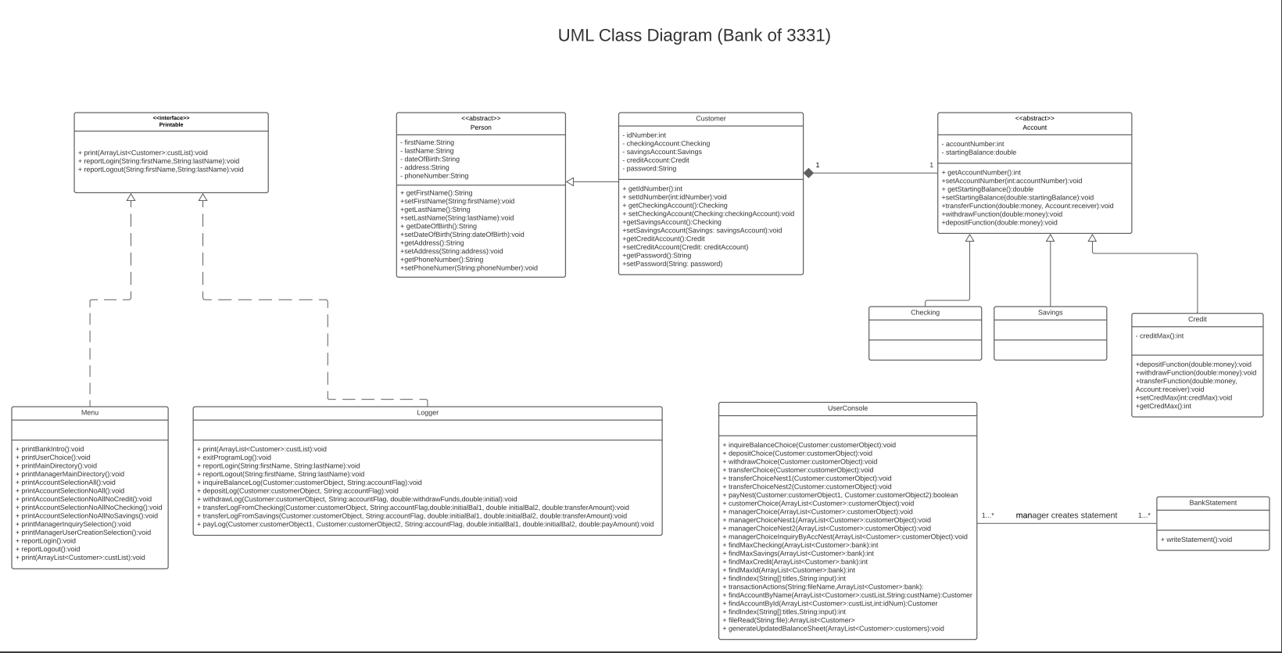
UML Class Diagram
Notes:
Abstract classes first
Describe the relationships
Person to customer (customer inherits from person)
Acc to subaccs
Account to Customer (Cannot have a customer without an account) (Composition)
Interface next
Implemented in logger and menu
Touch on the method overriding (polymorphism)
User Console has an association Bank statement

Slide 3
How did I use Object-Oriented Programming?
Customer extends person
We pass all accounts to the Customer class
Customer now can be instantiated with all data fields using constructor
Customer gains data from an ArrayList parsed from the input file
Verify if Customer exists using ‘for loops’
When a user is verified we use getters to obtain their information
Notes:
When a customer is created, they must have a savings account

Slide 4
How did I use Design Patterns?
We used the Singleton Design Pattern for our implementation
Implemented it for use with the Logger class
We created an instance of the Logger inside its own class
After the object is created, we set the constructor to private to prevent any further instantiation of the Logger
The only way to utilize the Logger is to call a getter which returns the only instance of the Logger
All method calls will point to the same object that was created earlier in the code
The logger only has methods that report about the any action a Customer performs
The logger only has a use for methods, no data manipulation necessary
Notes:
Only one instance of the class is needed to perform any given update to the log file.

Slide 5
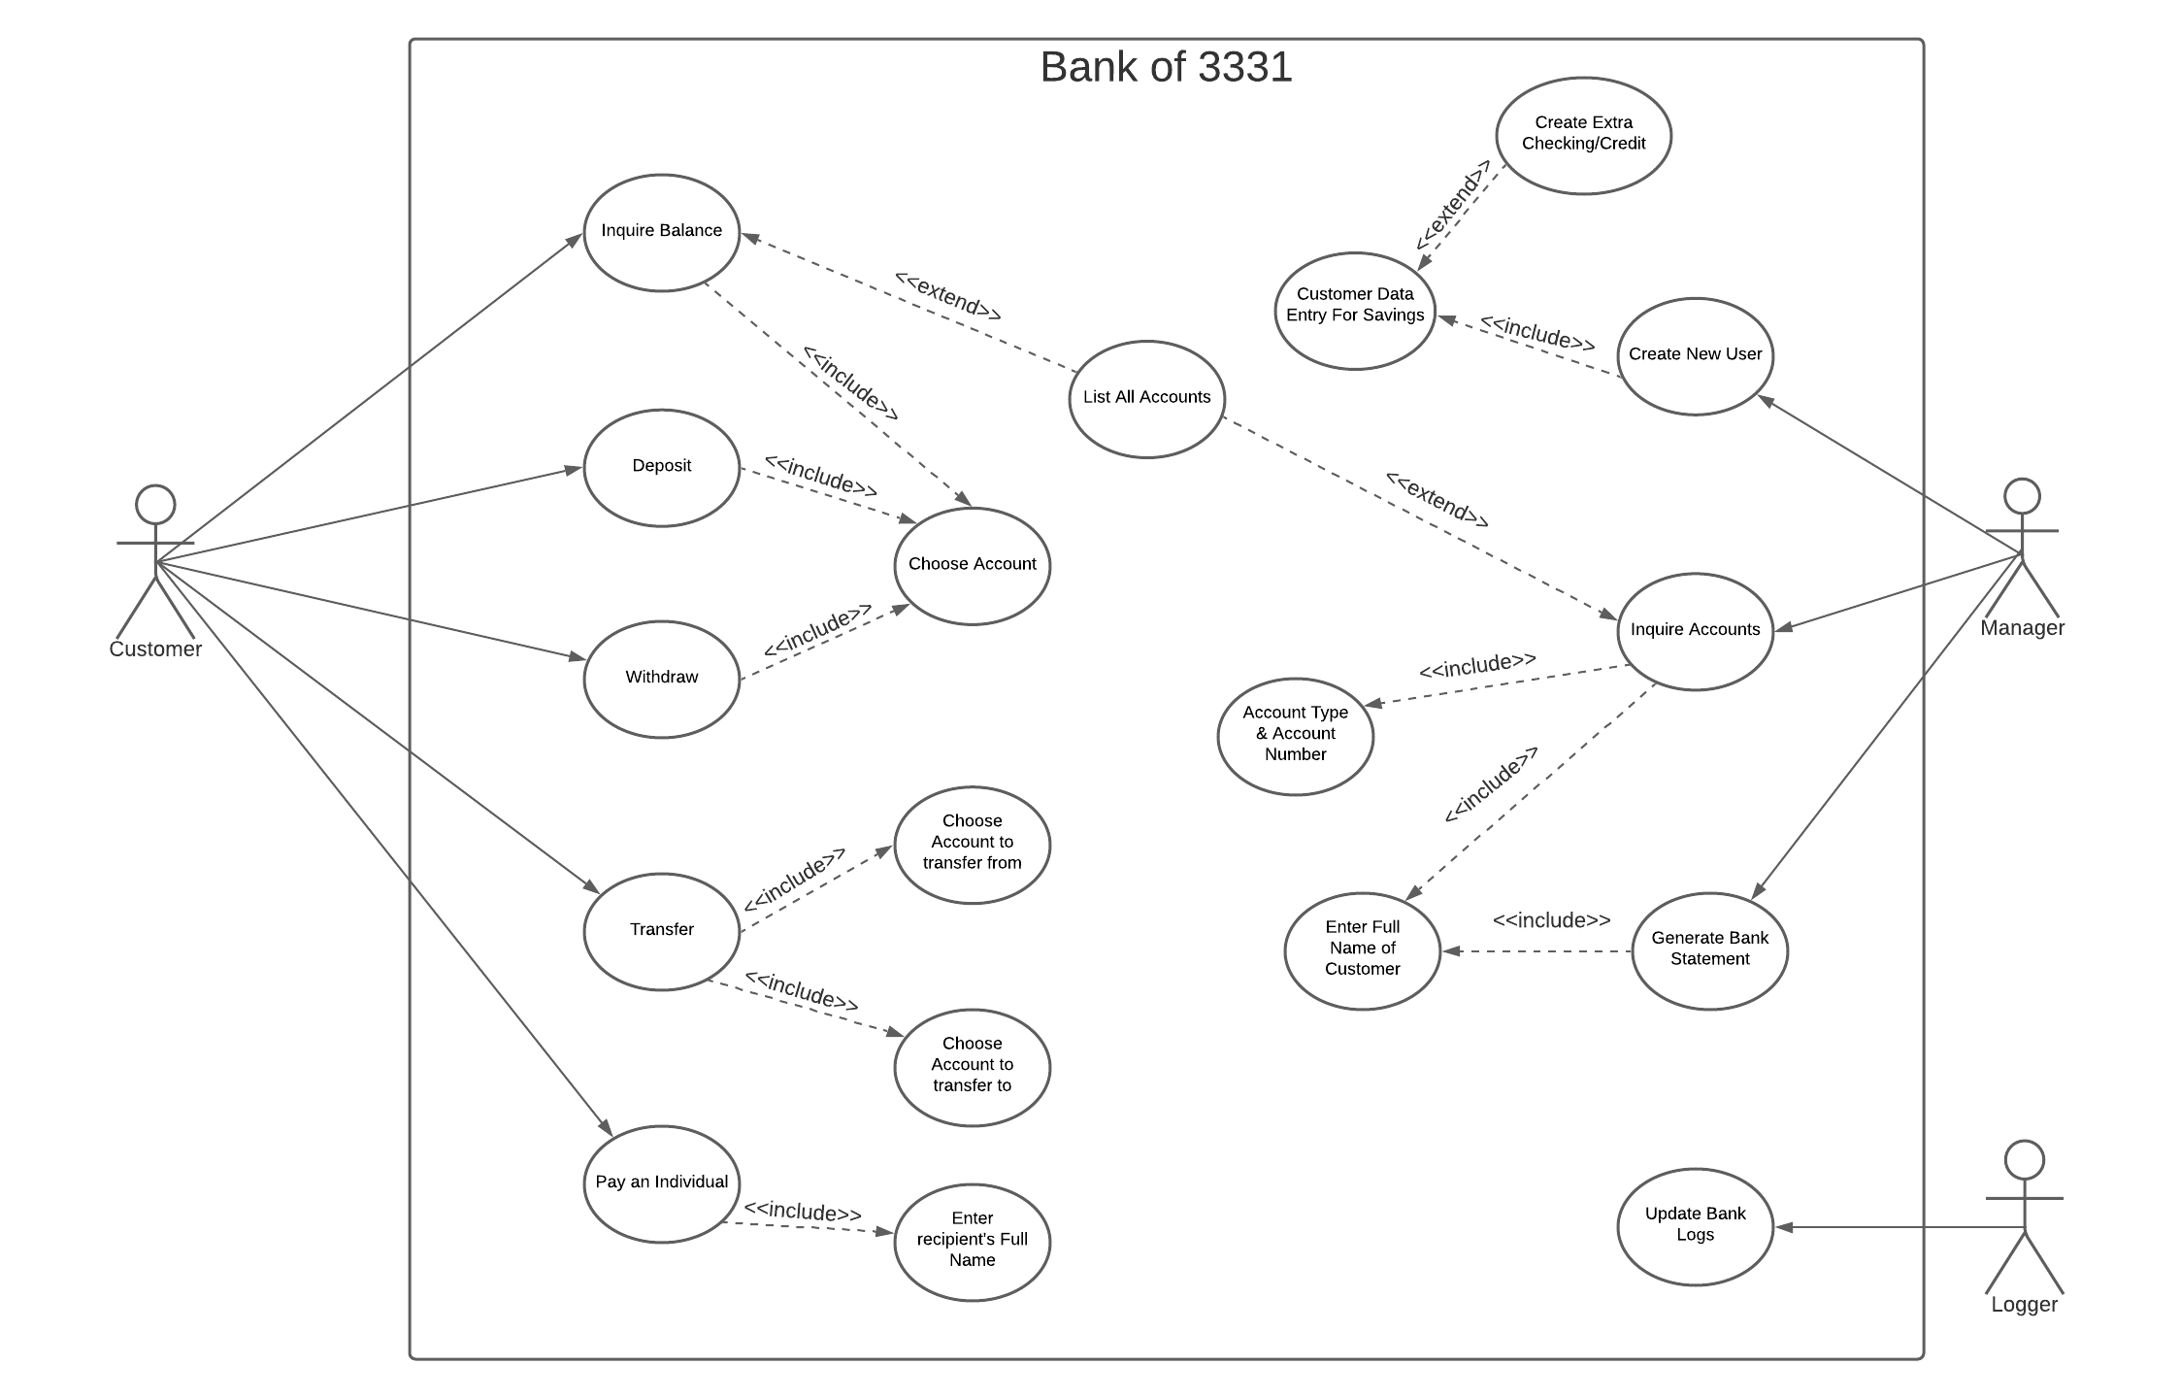
UML Use Case Diagram
Notes:
A customer has 5 reasons to use the bank
Inquire balance
Must choose the account
Option to list all accounts
Deposit
Must choose amount
Withdraw
Must choose amount
Transfer
Must chose account to transfer from and to
Pay
Must specify the name of the recipient
The manager has 3 reasons to use the bank
Create User
Must provide savings account info
Option to create additional checking or credit accounts
Inquire Account
Must enter full name of customer
Must enter account type and account number
Option to list all accounts
Generate Bank Statements
The logger has one function in the bank
Update Bank Logs

Slide 6
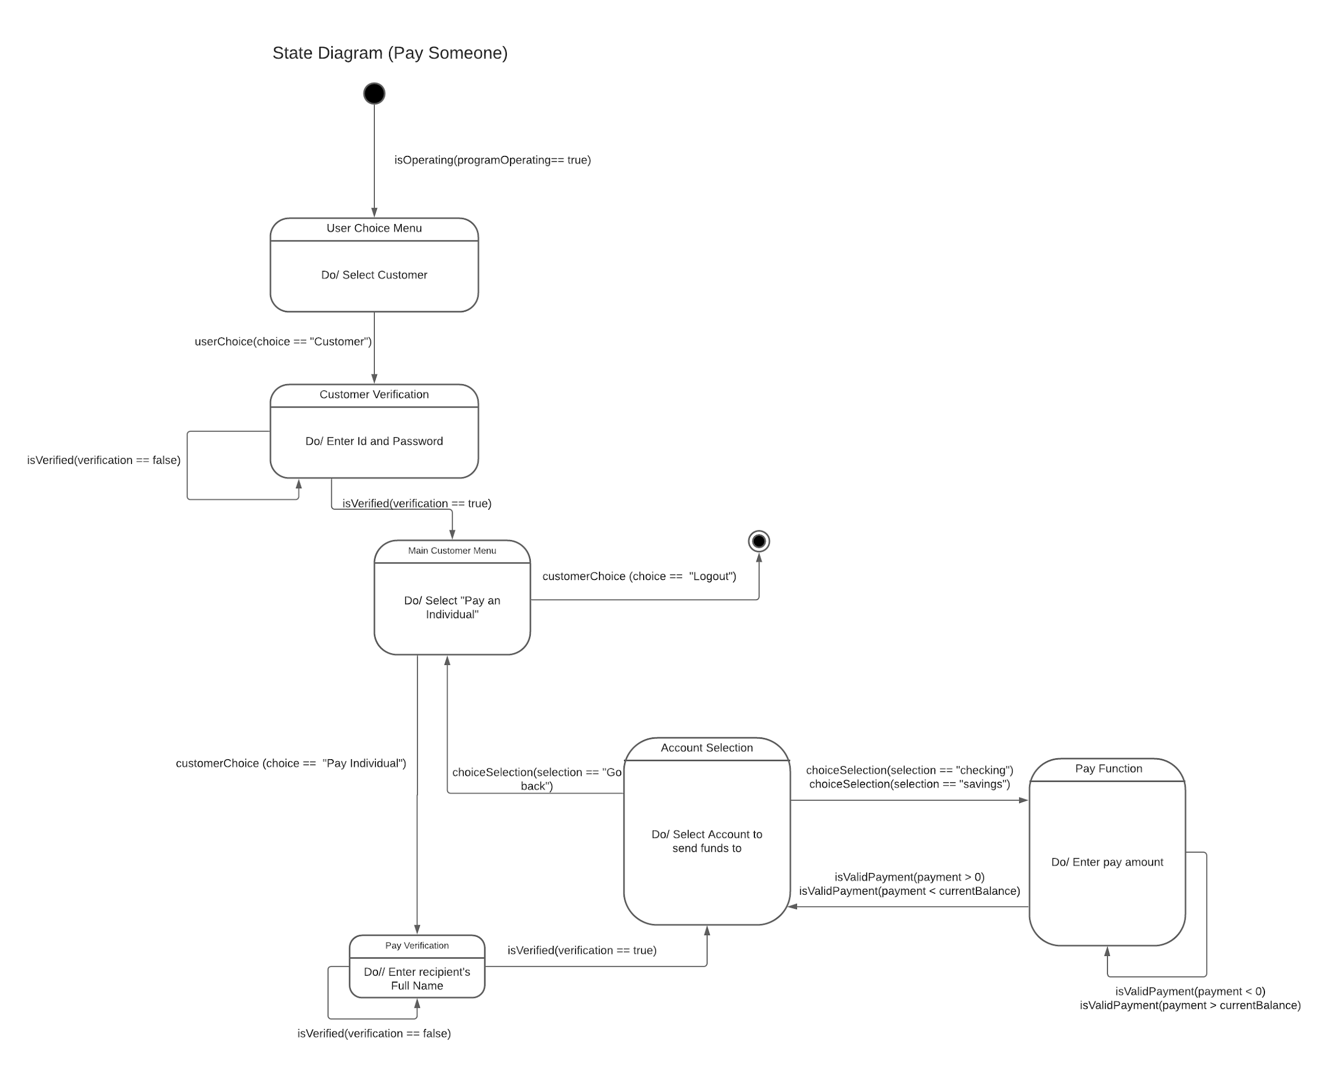
UML State Diagram

Slide 7
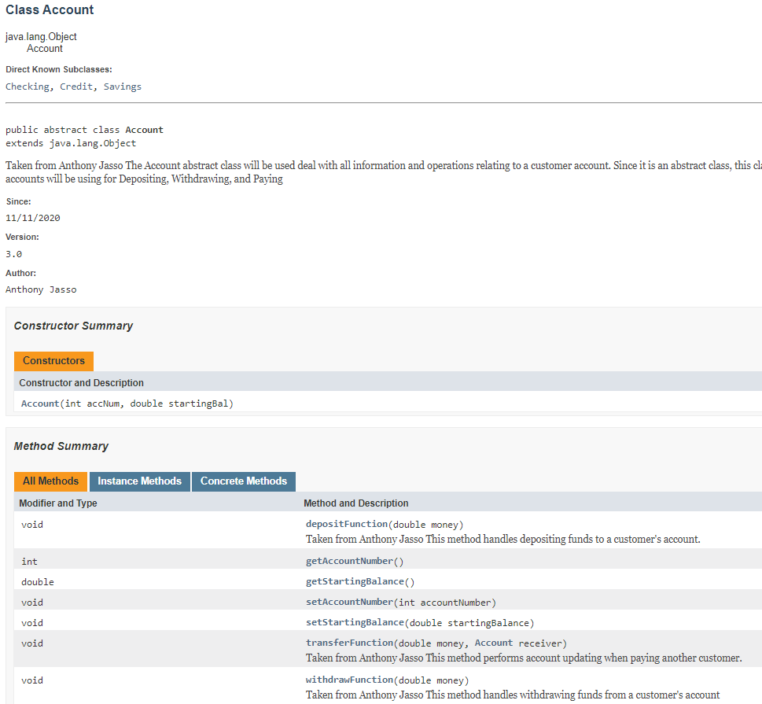
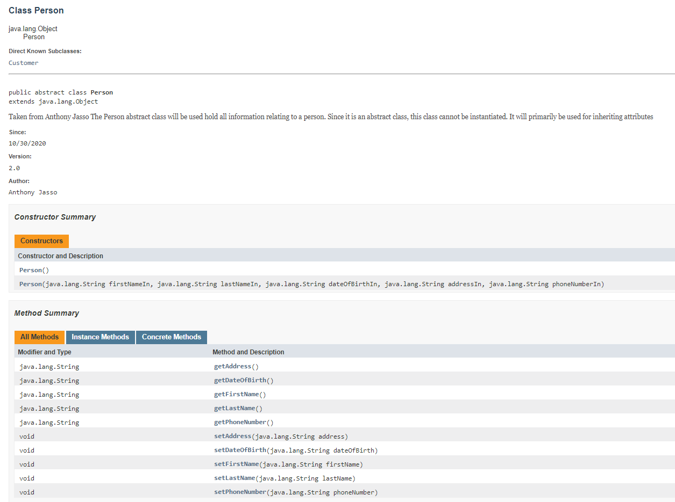
Javadoc

Slide 8
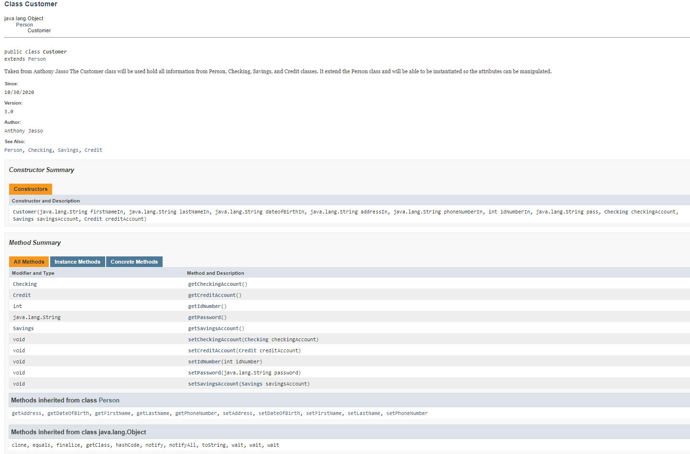
Javadoc

Slide 9
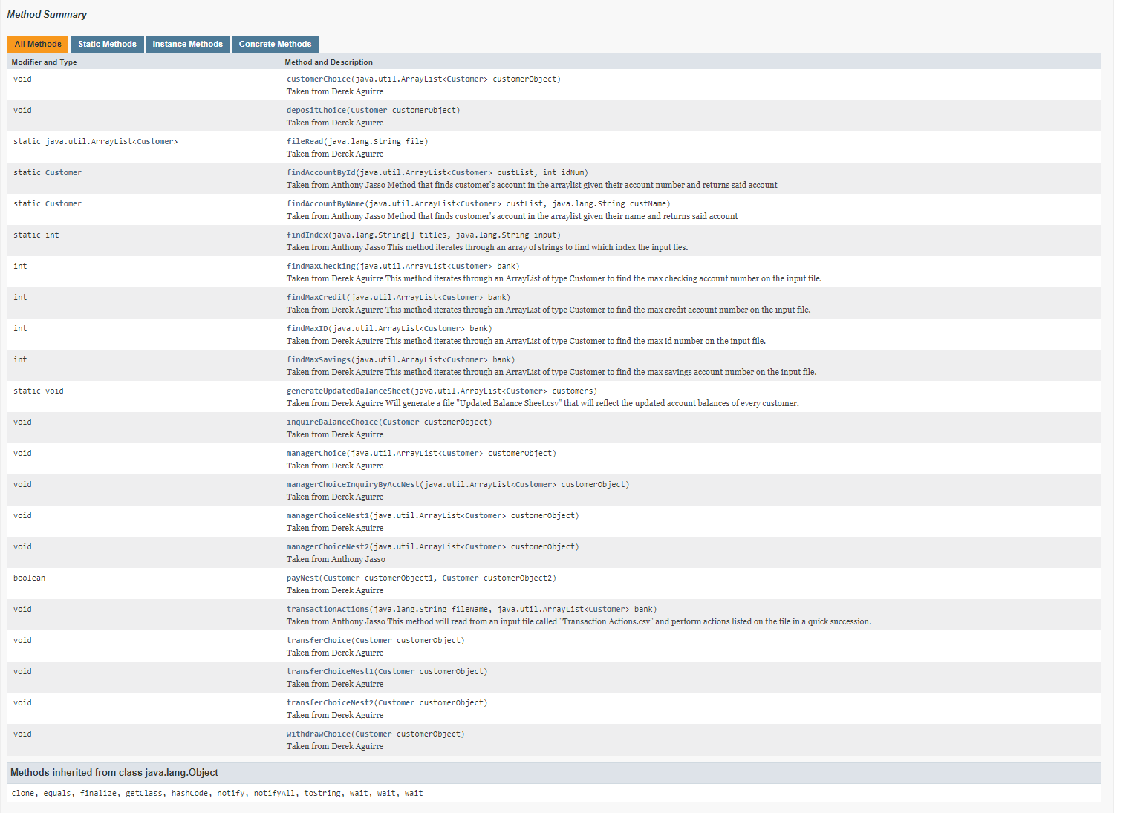
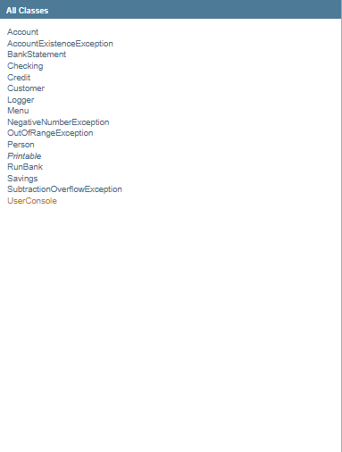
Javadoc

Slide 10
Reflections
What did we learn with the bank assignments?
Object manipulation
Implementing an Interface
Merging code
Maintaining a terminal-based UI using loops
Efficient exception handling
Polymorphism

Slide 11
Reflections
How did we grow as students?
Learned how to manage a large programming project
Effectively collaborate with another person
Problem solving approaches
Improved our skills at identifying and addressing errors
Optimize our solutions by refactoring elements of our code

Slide 12
Reflections
How did we break up the problem to complete this task?
Often switched between refactoring and adding new code
Integrated whiteboarding into planning sessions
Listed current and past bugs and assigned priority to them
Handed off the code to each other for fresh perspectives

